Slide 1
Statistics Guidance and Support
APEP (Research)
Matt Gittins
UoM Centre for Biostatistics

Slide 2
Outline
Part 1: Help and resources available
Part 2: Practical hints and tips
Collecting and handling your data
Analysis and interpretation
The elements of a successful project
Part 3: What is Expected?
What do we expect in an APEP project?

Slide 3
Your friendly neighbourhood statistician
Clinical research is inherently collaborative and multi-disciplinary
Success requires the right team
APEP project is just a taster of this
Statisticians are invariably part of that team
So helpful if you learn how to collaborate with us
Just as we can’t be expected to do surgery, doctors not expected to do statistics
But you need to understand the basics so we can communicate
Just as you don’t want to deal with every headache, cut or graze there is a set of straightforward steps that we expect you to be able to do yourselves –
Taking responsibility for your data,

Slide 4
Help Available – Collaborate
Part 1

Slide 5
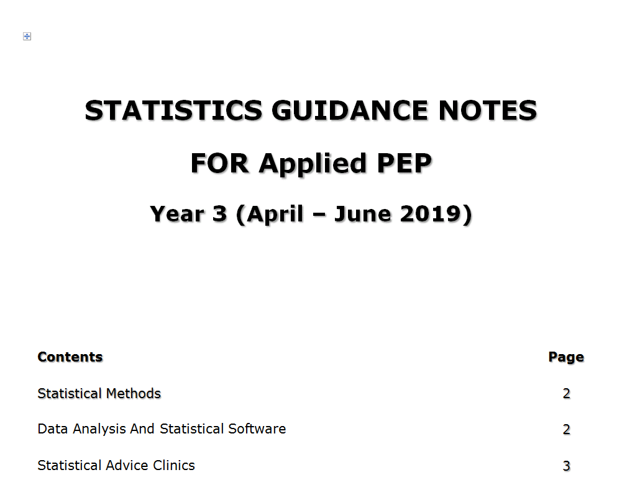
Statistical Resources for APEP
Details and links in
STATISTICS GUIDANCE NOTES FOR Applied PEP
Available online – details have been emailed – also below
See also further contact details in APEP handbook
http://research.bmh.manchester.ac.uk/biostatistics/teaching/statisticalsupport

Slide 6
One-to-one Statistical Advice
One-to-one advice with a statistician
Up to 3 sessions available - 30 minutes
Attempt to provide continuity
Good to meet fairly early on
Booking is required
Email - Mhs-Medstats@manchester.ac.uk.
State: Name
APEP Location (Central Manchester, Salford, Christie, Wythenshawe)
Short paragraph explaining project
Questions (2 or 3)
Bring any relevant documents as hard copies
Written draft of aims, objectives and outline design is helpful
Note – different system at LTH (Preston) – see APEP guidelines document

Slide 7
Software For Statistics
SPSS (version 22/23)
available to from IT Services web pages www.itservices.manchester.ac.uk/software/.
You are advised to obtain the software well in advance.
StatsDirect
a limited time trial version can be downloaded from www.statsdirect.com
You can also request a license by contacting the IT Service
Self instruction booklets for SPSS and StatsDirect
http://research.bmh.manchester.ac.uk/biostatistics/teaching/statisticalsupport
Some statistical resources on the internet including self-teaching materials and software can also be accessed from these web pages, and booklets

Slide 8
Learning to use SPSS/StatsDirect
Self –instruction guides
Built-in help
Loads of internet tutorials on SPSS – Links in notes
Ask straightforward questions
One-to-one sessions can help with specific problems associated with your data/analyses

Slide 9
SPSS or StatsDirect?
SPSS – comprehensive, widely used package.
Good for data entry, surveys, standard statistics, large datasets
Poor at confidence intervals, specific medical stats missing
Use if you have a large (>100) or complex dataset.
Use if want to learn an industry standard package
StatsDirect – written for medics.
Not suited to large, complex datasets. Poor missing value handling
Good coverage of the methods used in medical data
Agreement studies; diagnostic test studies
Excellent calculators if have your data already summarised
Use if small dataset or if already know the program
Use if your study is about agreement or validating a diagnostic test rather than testing differences

Slide 10
Some Useful Statistical Texts
Introductory
Campbell MJ & Machin D (1990) Medical Statistics: A Commonsense Approach. West Sussex. John Wiley & Sons Ltd.
Bland M (2000 ). An Introduction to Medical Statistics. Oxford: Oxford University Press.
Gardner MJ & Altman DG. (2000) Statistics with Confidence: Confidence Intervals and Statistical Guidelines. London: BMJ Publishing.
More Advanced
Altman DG (1991). Practical Statistics for Medical Research. London: Chapman & Hall.
Armitage P & Berry G (1994). Statistical Methods in Medical Research. Oxford: Blackwells.
BMJ statistical notes

Slide 11
Questions?

Slide 12
Practical Hints and Tips
Part 2

Slide 13
Practical Hints and Tips
Designing your study
Data Collection
Data management, entry and cleaning
Analysis and interpretation

Slide 14
Keep It Simple!
Don’t be too ambitious:
a small well-designed project is preferable to a large diffuse one.
Make sure that your project design is as simple as possible while remaining compatible with the aims.
Some supervisors have unrealistic expectations as to what is possible in 10 weeks.
Seek advice if you feel expectations are unrealistic
Do challenge unrealistic expectations!
Don’t take on overly complicated analyses

Slide 15
First Design your Study
ITERATE
Write down clear short list of Aims and Objectives
Write down the hypotheses you are testing or the outcomes you are estimating or the standards you are auditing against.
And consider them critically
Don’t try to investigate too many questions or you will end up answering none!
Design the data collection to address the hypotheses or measure the outcomes
Limited by access approvals in place
Once you have designed your study re-evaluate your study objectives.
Can your data answer the question?

Slide 16
Audit or Research?
Audit
Research
Interest is in the specific set of patients/people/…
Your data is typically all the population of interest
Question: Are pre-specified standards being met in this place at this time?
Analysis is descriptive – how many meet the standards? Who does not?
Want to make generalizable conclusions about all patients
Your data is a sample of those you are interested in
Questions: Does your data provide evidence for a pre-specified hypothesis about the population? What are the characteristics of this population?
Analysis involves estimation of values, differences or strengths of association.

Slide 17
Before you collect any data
Think about Data Protection and Confidentiality
Do not enter participant’s names or other information that may compromise the anonymity of the data and confidentiality.
Names, addresses
Hospital numbers
Postcodes
Combinations of rare characteristics
Use a unique study number for each subject in your study to relate your electronic data to your paper record forms.
Check what is in all the fields in any electronic data you are given
Anonymise before you take a copy for analysis
Even so treat data as confidential
University password-protected servers or encryption
Seek advice on confidentiality if you have any doubts
Think what would happen if you lost/someone stole your laptop/ipad/memory stick and someone found it and handed it to the Daily Mail!

Slide 18
Data Collection
Every time you add another variable to your list ask yourself “Do I really need this information?”
Datasets available electronically
Check fidelity of transfer
Beware of formatting – especially dates
Be selective – don’t over-extract
Confidentiality issues
What is in the columns you are not going to use?
Manual collection (eg patient notes)
Design and test a proforma
Avoid banding of values – can do that later
Think through the whole project
You don’t want to have to go back to the notes!
But don’t waste time collecting data you will never need

Slide 19
Questionnaire Design
Don’t include too many questions in your questionnaire
Think carefully about the order of questions.
Avoid complex conditional questions if possible.
Check carefully that options include everybody.
e.g. Age bands; no religion; cultural differences
Ask a friend to complete your draft forms and comment on ease of use.
Time how long it takes to complete any questionnaires.
Pilot any questionnaire or data collection forms.
Some questionnaires should not be modified as they are standard instruments - HADS, SF36 etc.

Slide 20
Data Management
Give each subject in your study a unique id number.
This unique id number can then be used when you enter the data for analysis.
Avoids entering personal identifiers
This is particularly important if you want to link data from different sources.
Keep identifiers safe (not on the same computer!)
Data can be entered directly into StatsDirect and SPSS.
Alternatively StatsDirect and SPSS can read EXCEL worksheets.

Slide 21
Entering data
Data should usually be entered into a single worksheet.
Use one row for each ‘subject’ (patients, participants, laboratory sample).
Each column should then be a particular piece of information or “variable” for all subjects.
If one patient can have multiple values, code as separate yes/no columns
The first row of the spreadsheet should contain the variable names.
Something short, no spaces or punctuation (except “_”)
Where the subjects are divided into several groups don’t split into several spreadsheets.
Enter all data onto one sheet.
Add a variable with a numeric code for each group.

Slide 22
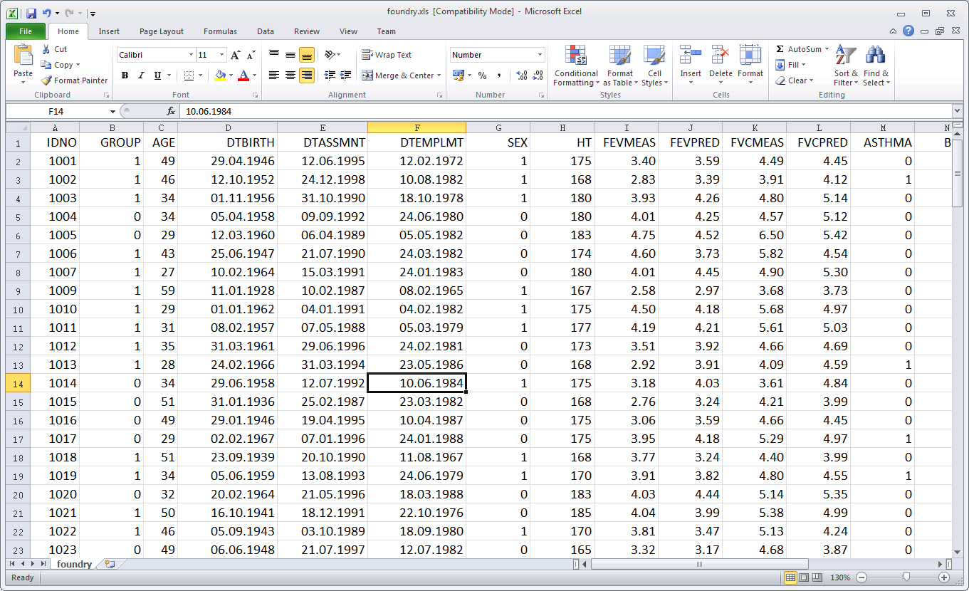
Data (Foundry example excel)
UNIQUE ID
VARIABLE NAMES
S
U
B
J
E
C
T
S
Notes:
Keep list of numbers<->real people somewhere safe!

Slide 23
Coding Data
A statistical package will treat the text “Yes” “YES” and “yes” as different categories.
Use numerical codes for categories so they can be entered as numbers rather than as text to simplify data entry.
E.g. Use “0” and “1” for “yes” and “no” or “male” and “female” .
Use the software:
Search and replace in Excel to check and change data
Define a set of value codes, or drop-down boxes
Don’t mix text with numbers in the same variable
Can code missing (eg as 999) and tell SPSS this is missing
Leaving blank in Excel will also work for missing values
Avoid “<“ and “>” and essays (comment columns can be useful)

Slide 24
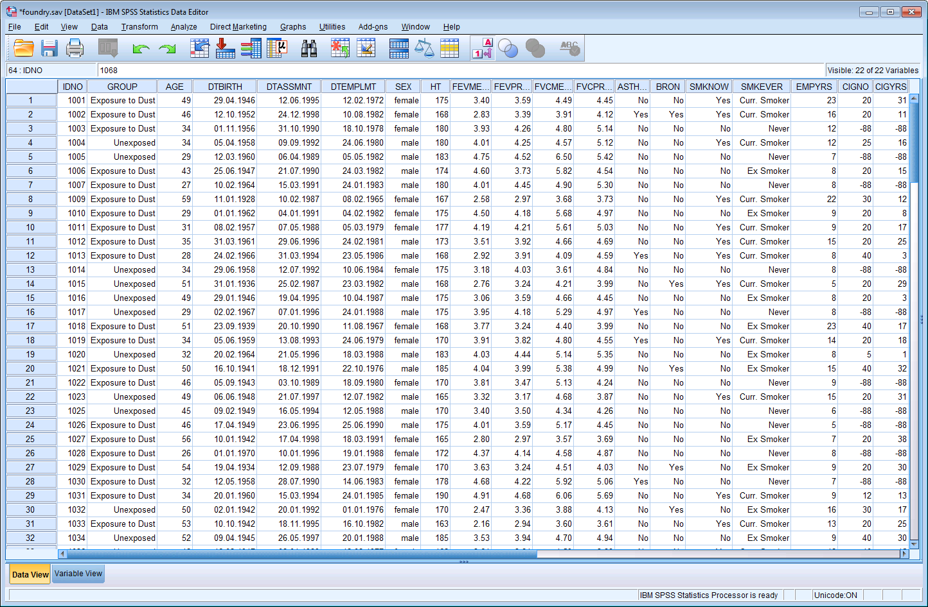
Data (Foundry example SPSS)

Slide 25
Data Cleaning
Once your data is entered ….
Check it for sense
Summary parameters – mean values, range
Plots – histograms, scatterplots
Cross-tabulations
Don’t remove data without a good reason
But check suspicious values at source and confirm
If results depend on a few extreme values report sensitivity analyses
Non-parametric?
With and without the aberrant points

Slide 26
Data Analysis
Appropriate to your study question
Hypothesis tests and p-values are not compulsory
Audit is about counting
Many research studies are about describing groups of patients and their outcomes
Hypothesis tests are about comparisons
Descriptive statistics are good statistics
Keep it simple – use tests you have met before – but know their limitations
Use the Stats clinics (and Piazza) for advice

Slide 27
Over-the-counter statistics
Comparing groups – measurement a real number
T-test; Mann-Whitney U test
Paired t-test; Wilcoxon test if paired
Oneway ANOVA; Kruskal-Wallis test
Comparing groups – measurement categorical
χ² test; Fishers Exact test
Relative risk, Odds ratios
Relationship between two variables– measurement real numbers
Linear regression (both numbers)
Correlation (Pearson or Spearman)
Diagnostic tests
Sensitivity, specificity, predictive value

Slide 28
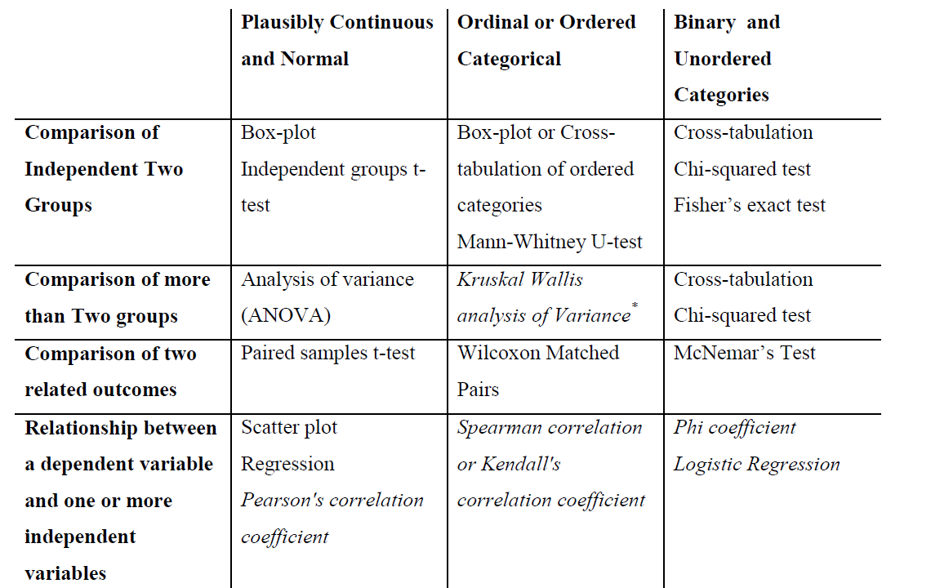
Which test do I pick off the shelf?
Many crib sheets for over-the-counter methods
eg in the notes for the statistical software labs
Use with caution – if in doubt consult a statistician

Slide 29
Prescription Only Statistics
Survival Analysis (Time to event)
Logistic regression
Multiple regression
Two-way ANOVA
Measurement studies
Agreement – Kappa, Bland-Altman
Notes:
Measurement – how good is this test?

Slide 30
Brain Surgery
Most forms of multiple regression
Predictive models
Complex adjustment
COX models
ANOVA models beyond two-way
Interactions
Random effects, mixed models, multilevel models
Repeated measures
Factor analysis
Propensity score models

Slide 31
Always read the label
You should read up about any statistics you use
Make sure you understand what they are doing
More important: explore and understand your data
Plots
Summaries
Tables
Inter-relationships

Slide 32
Interpretation - What does it mean?
Effect Estimates
Absolute difference
= Risk^{A} – Risk^{B} / Mean^{A} – Mean^{B}/Linear regress
= e.g. 2% - 0.5% = 1.5%
Relative difference
= Risk^{A} / Risk^{B} or Odds^{A}/Odds^{B} or logistic regress
= e.g. 2% / 0.5% = 4
Odds – Ratio of event occurring vs not occurring
Statistically Sig (P-val≤0.05) vs Clinically Sig
Confidence Interval (95% C.I.) = accuracy!

Slide 33
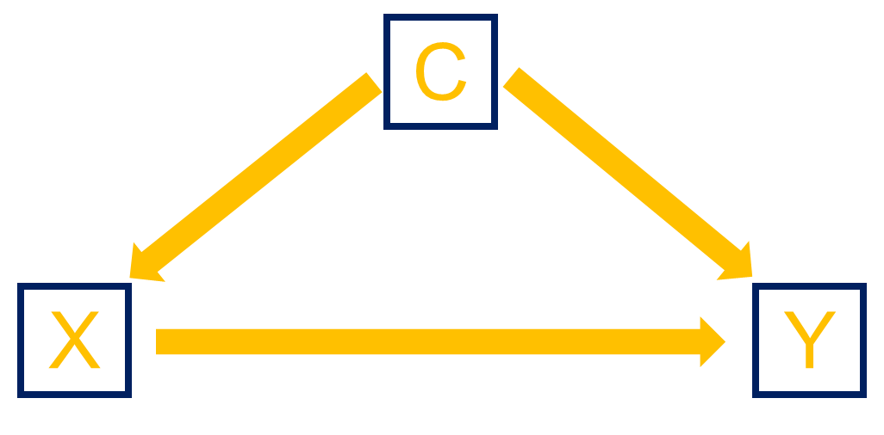
Is it all it seems?
Confounding
A third variable which has the potential to affect both the measurement and the variable being assessed.
Eg case mix; time periods (before/after)….
Identify and demonstrate confounding (or lack of it)
May be able to adjust statistically (ask for help!)
Is the sample representative?
Inclusion/exclusion?
Selectively missing data?
Setting?
Power?
Hawthorne effect
People behave differently if they know they are being observed

Slide 34
Red Flags
No clear hypothesis or parameter to be estimated
Multiple measurements (of the same thing) on the same people
Multiple hypothesis tests
Incompletely observed outcomes
Survival or time to event which hasn’t always happened
Non-random sampling
Potential confounding
Missing data (…)

Slide 35
Missing data
Try to avoid it!
Acknowledge it
Describe it
Who/what is missing?
Think about the reasons and consequences
Why missing?
Explore the consequences
How big a difference could it make?

Slide 36
What is expected?
Part 3

Slide 37
What is expected
Clear aims and objectives
A study compatible with your aims
Good data collection and management
Appropriate, simple, analyses
Do not use methods of analysis that you don’t understand
You will not get marks for unnecessarily complicated analyses - certainly not if you get them wrong!
It is important that you understand what you are doing.
Better to use simple methods of statistical analysis that you fully understand correctly.
Correct interpretation of the result

Slide 38
What is expected (continued)
Self Critical review
Sample – how representative? Biases?
Data – strengths and weaknesses? Missing data?
Biases
Confounding – are there alternative explanations for your results?
Analysis – are there things you haven’t accounted for? What else might be needed?
Awareness of the literature
Don’t believe all you read in the papers!
How do your results compare? Effect sizes not P-values!
KEEP IT SIMPLE

Slide 39
Summary
Don’t worry about the statistics
Keep it simple
clear aims, clean design and straightforward analysis
Take care with your data
P-values are not compulsory
Critical evaluation is compulsory
Don’t believe all you read in the papers
Help and software training is available
Good luck!

Slide 40
Questions?
Slides and Guidance notes available via Piazza

